Slide 1
Git
Elias Carlston, DevelopIntelligence
elias@eliascarlston.com
https://github.com/eliasjames/training-git

Slide 2
Day 1 Schedule
Introductions / Icebreakers
Course Overview
Commits
Branching and Merging
Lunch
Remotes
History

Slide 3
Introductions
About me
About you
Your name & brief experience
Something you look forward to learning
Something non-work related

Slide 4
Course Overview
Goals
Develop good version control habits
Use command-line API

Slide 5
Basics
Why Not Git?
Git is notoriously difficult to learn
( because it covers a difficult domain )
Expect to have to memorize several commands
Several commands can destroy unsaved data

Slide 6
Basics
Why Git?
Once saved, Git protects data extremely well
( not all VCS can claim that )
Decentralized
Massively redundant
Offline capable

Slide 7
Basics
Safe, if you Keep Both Hands On The Saw
Do it The Git Way

Slide 8
Think in versions
Overly simple version control method #1

Slide 9
Think in versions
Overly simple version control method #1:
No changes allowed
Disadvantages: obvious
Advantages: consistent, reliable
"immutable"

Slide 10
Think in versions
Overly simple version control method #1a:
"Save as" / "make a copy" technique
git-notes1.txt, git-notes2.txt etc
Advantage: easy to understand

Slide 11
Think in versions
Many drawbacks to "save as" approach
Lots of costs associated with storage
Comparing versions difficult
Overwriting ("clobbering")
Dependent on network connection ("checkout")

Slide 12
Think in versions
VCS' difficult domain: Time Travel
Legal system also uses version control
Need to know document contents by time
Supports rollback to "known good state"

Slide 13
Think in versions
Time travel gets weird

Slide 14
Think in versions
Think in versions
git-notesN.txt - not really separate files
Using separate files to represent time
One file, multiple versions
aka "states"

Slide 15

Think in versions
Logical (file name)
git-notes.txt
Tuesday
Wednesday
Thursday
Physical (file storage)
* States *

Slide 16
Terminology
Common VCS terms ( and Git-specific details )
Commits
Repository
Working Copy
Branches
Head
Git Index

Slide 17
Terminology
Commits
Represent states
Snapshots in time, Immutable
Unique IDs
Always additive

Slide 18
Terminology
Repository
History of all commits & management tools
Decentralized - no Git repo differs from another
Usually, one repo designated as hub
But if the hub is lost, promote any spoke

Slide 19
Terminology
Working copy
Current state of the source files
Git repository has history of all commits
Working copy is generated from one graph
Git changes physical files to match logical

Slide 20
Terminology
Branches
History: commits have ancestors
Git branch name labels a commit
Furthest commit called "tip"
Common ancestor called "trunk"

Slide 21
Terminology
Head
A pointer indicating the "current" commit
Not just the newest - can point at any commit
Fast forward or rewind on the branch
Like the 'play head' on a tape
Uppercased in code ( HEAD )

Slide 22
Terminology
Git Index
A proposed list of changes for next commit
Also called 'staging'
Changes can be added & removed
'commit' saves only staged changes to head

Slide 23
Lab: Get Started
Create a new directory, "git-sandbox"
'cd git-sandbox'
'git init'
Examine hidden '.git/' directory (use 'ls -a')

Slide 24
In Practice
git subcommand --option/-o param1 paramN -o
Think "git verb object adjectives"
Options (mostly) work the same in either position

Slide 25
In Practice
git status [path]
List differences between working copy and head
Detects addition, removal, and modification of files, including meta-data like permissions
Passing path (optional) filters results

Slide 26
In Practice
git commit [-m "commit message"]
Save (some or all) working copy changes permanently
Changes to be saved come from staging/index
Makes index into new head

Slide 27
In Practice
git add path1 […pathN]
Add files to the index ( displayed by 'status')
All changes within those files will be committed
"Unstaged" files will not
Commit does nothing if index is empty

Slide 28
In Practice
git log
Displays history
Without options, shows basic info for history of current branch
Very powerful, many options
--oneline reduces output to just ID and message

Slide 29
In Practice
Notice no (common) commands to undo or revert
In Git, changes are all additive
This is how Git protects your data
The Git Way: fix the mistake with a new commit
Avoids "time traveller paradox" type problems

Slide 30
Lab: Git-ception
See how Git works by putting itself under VCS
(not something you'd ever do outside class)
'cd' into the .git/ directory
'git init' & 'git status'
'git add --all' & 'git status'

Slide 31
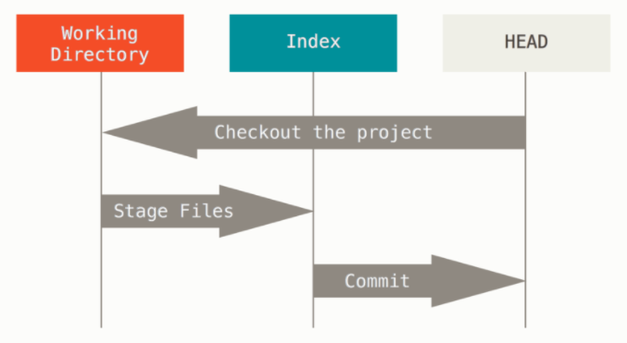
What's going on?
Three phases of Git workflow
https://git-scm.com/book/

Slide 32
CLI Tips
Basic keyboard shortcuts
ctrl+a / ctrl+e: beginning/end of line
ctrl+w: delete a "word" at a time
up / down arrows: scroll through cmd history
ctrl+r: search command history

Slide 33
CLI Tips
Special characters
~ (tilde): home directory ( 'cd ~/project' )
!$: last argument to last command ( 'echo !$' )
. (one dot): current directory ( 'cd .' stays put )
.. (two dots): parent directory ( 'ls ..' )
note 'ls' takes path as argument ( 'ls ~/project' )

Slide 34
CLI Tips
Aliases
'alias gs="git status"', then run 'gs'
Aliases created during a session disappear at end
Add aliases to ~/.bash_profile ( ll="ls -la" )
bash_profile is re-loaded at login
To re-load during session, 'source ~/.bash_profile'

Slide 35
CLI Tips
Aliases - Beware!
Will NOT warn if the alias already exists
alias git='echo "Get In Touch"' // breaks git
Always try the short name before creating
"command not found" === green light
Don't get clever, keep it simple

Slide 36
Lab: add & commit
Change directory back to git-sandbox
Create an html file
'git add file.html' & 'git status'
'git commit -m "first file"' & 'git status'
Modify file.html & 'git status'
Repeat add & commit

Slide 37
Lab: Examine Nodes
git cat-file -p unique-ID
Displays contents of certain nodes
Commits, trees, blobs
-p for pretty-print

Slide 38
Lab: Git-ception II
Change directory to git-sandbox/.git/
'git status', 'git add -all', 'git commit', 'git status'
cd git-sandbox, modify file.html, 'git status'
cd git-sandbox/.git/, 'git status'
cd git-sandbox/, add & commit
cd git-sandbox/.git/, 'git status'

Slide 39
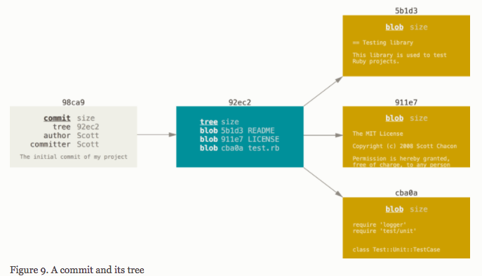
What's going on?
Commit => Tree => BLOBs
(Binary Large OBject)

Slide 40
Clean up Git-ception
Git repo === .git/ === an ordinary folder
Delete the files to remove
'rm -rf git-sandbox/.git/.git/'
'git status' // fatal: This operation must…
You'll get that same error from 'gs' anywhere outside a repo

Slide 41
Lab: Practice
We need a commit history
Let's make a lot of changes
Create style.css & link to it from file.html
Make those separate steps
Write good messages

Slide 42
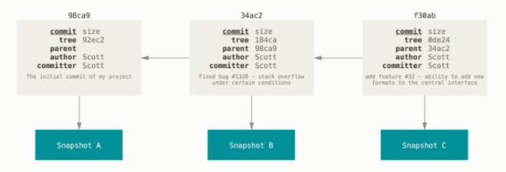
What's going on?
Every commit points at a parent and a snapshot
'git log' shows this by default
https://git-scm.com/book/

Slide 43
Mistakes
git remove
Removes files from the staging area
In the next commit, removed from snapshot
Also removes the physical file ( 'rm' )
Gotcha: working copy not changed if staging area is reset

Slide 44
Mistakes
The Git Way is additive
Make new changes to fix
But sometimes things have to be modified
Head
Index
Working Copy

Slide 45
Mistakes
git checkout path
Keep Both Hands On The Saw!
Resets file(s) to match working copy to snapshot
Will destroy uncommitted changes
Use this to abandon work & go back to HEAD

Slide 46
Mistakes
git checkout path
Will modify physical files if they've been edited
Will restore physical files if they've been deleted
Not vice versa - physical files whose logical files have been deleted just show up as 'untracked'
Another signature for checkout coming later

Slide 47
Mistakes
git commit --amend
Replaces the snapshot with the current staging area
Modify, add or remove anything - new snapshot
Even if no index change, message updates
Use freely, but only on last commit

Slide 48
Mistakes
git clean path
Keep Both Hands On The Saw!
Removes untracked files from path
Won't actually delete without --force/-f
Won't delete directories without -d
Common form: 'git clean -df .'

Slide 49
Mistakes
Stay Safe
Don't try to edit history, it's not safe
Having the correct state at tips is what matters
Misusing Git leads to heartache
'Fixing' past code causes other problems

Slide 50
Mistakes
Renaming files
'mv style.css booyah.evs'
What happened?

Slide 51
Mistakes
Renaming files
'git rm style.css' & 'git add booyah.evs'
'git status'
Now what happened?

Slide 52
Mistakes
Renaming files
renamed: style.css -> booyah.evs
Git can recognize renames
File content stored separately from file name

Slide 53
Mistakes
Renaming files
git mv
Changes physical file & adds to staging

Slide 54
Mistakes
git reset
Changes where HEAD points to
May alter staging and working copy to get there
Potentially dangerous

Slide 55
Mistakes
git reset path
This form changes staging area to match index
IOW, does the opposite of 'git add path'
Use it to 'back out' items from staging

Slide 56
Mistakes
git reset --hard path
Keep Both Hands On The Saw!
Changes staging area AND working copy
Will destroy all uncommitted changes

Slide 57
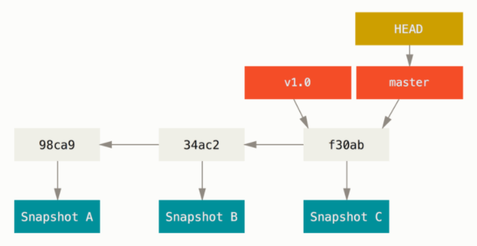
Branches
Branches are labels pointing at chains of commits

Slide 58
Branches
master branch
Default branch is named 'master'
Nothing special about it, except 1st commit has no parent
Primary, stable branch by convention
Convention is strong - don't rename

Slide 59
Branches
git branch
Lists branches in this repo
Current branch is noted
Asterisk before the name
Colored green

Slide 60
Branches
git branch name
Creates new branch
Will error if 'name' already exists
Gotcha: Does not switch head! Try 'git status'

Slide 61
Branches
git checkout branch-name
Moves head to branch tip
Changes working copy to match head
If there are uncommitted changes to WC…
Aborts if the new branch would affect them
Proceeds if the new branch would not destroy

Slide 62
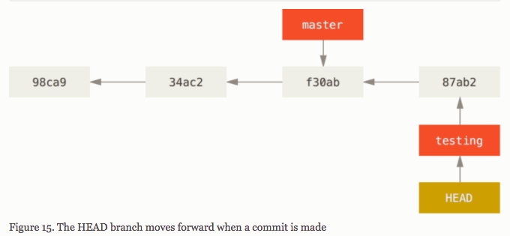
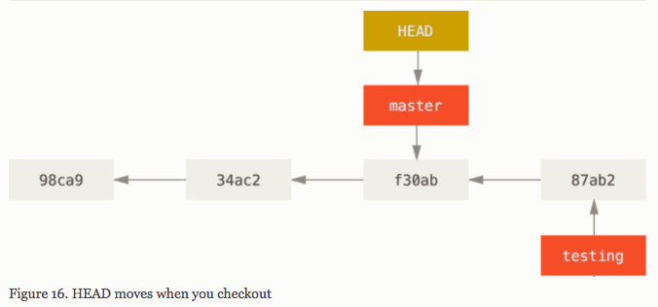
Branches
Labels are easily moved

Slide 63
Branches
git checkout -b branch-name
Creates new branch & tries to switch head
Also errors if uncommitted changes exist
Idiosyncratic API syntax, but most convenient

Slide 64
Lab: Branches
Create two new branches (git checkout -b)
Make different changes on each branch
Switch between branches & master
Observe changes to working copy

Slide 65
Merging
'master' defined as primary, stable branch
Branches allow teams to work separately
Successful branches' work moves to master
Unsuccessful branches can be discarded

Slide 66
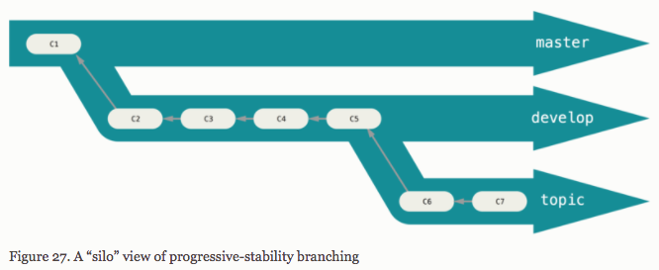
Merging
Branching workflow

Slide 67
Merging
Merging process combines two sets of history
Such that they're indistinguishable later
Can be undone, but it's technically challenging
Measure twice, cut once

Slide 68
Merging
Topic branches
short-lived
Exist to solve one task
Merged back into parent

Slide 69
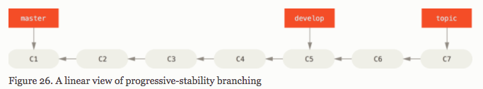
What's Going On

Slide 70
Merging
Three types of merge
fast-forward
Merge commit
Merge conflict

Slide 71
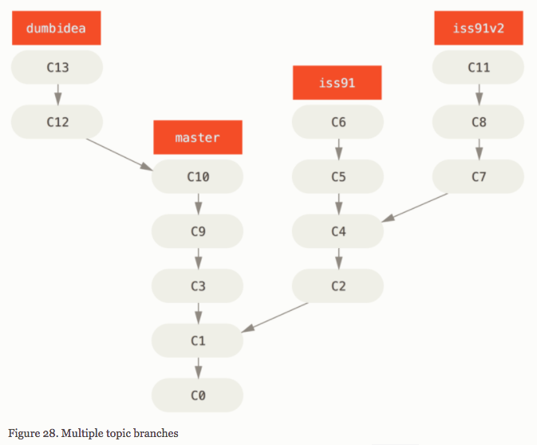
Merging
Presented at code review:
iss91
iss91v2
dumbidea
Approved for merging
iss91v2
"fast forward merge"

Slide 72
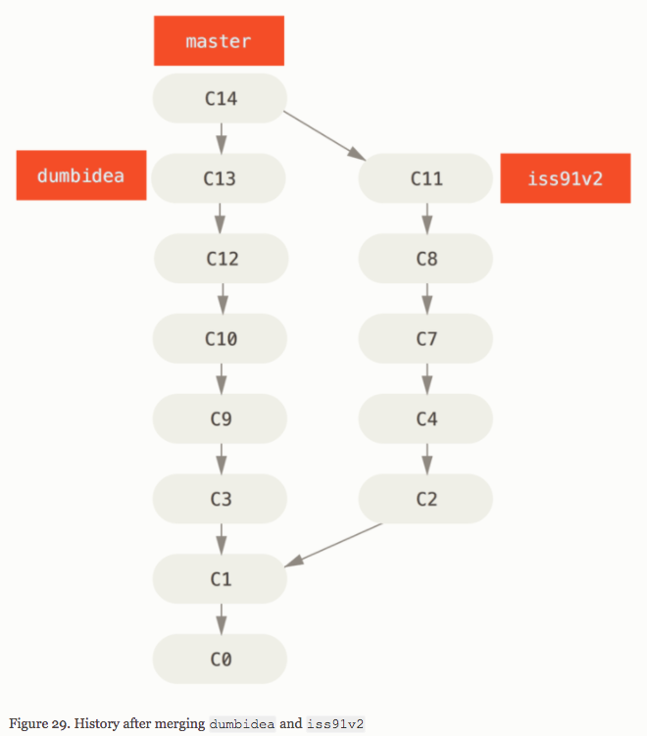
Merging
But what if dumbidea
was actually great?
"Merge commits" can have
multiple parents - just
combining more history

Slide 73
Merging
Say C13 and C4 change
the same line in the same
file ( has to be same line )
"Merge conflicts" result from
incompatible history
Fix the working copy
manually and the result
gets used as the
merge commit

Slide 74
Lab: Merge conflict I
Set up scenario to cause merge conflict
Create two new branches
Modify the same line in two different ways
Merge one branch back to master
Then the next branch will cause conflict

Slide 75
Merge conflicts
Git needs to tell you which lines
Modifies the working copy
Inserts "conflict markers" into file
These show the changes from both sides

Slide 76
Merge conflicts
Conflict markers
Starts: '<<<<<<< branch-name: file-name'
Ends: '>>>>>>> branch-name: file-name'
Delimiter: '======='
Delimter separates conflicting lines

Slide 77
Merge conflicts
Conflict Markers
<<<<<<< HEAD:index.html
<div id="footer">contact : email.support@github.com</div>
=======
<div id="footer">
please contact us at support@github.com
</div>
>>>>>>> iss53:index.html
Edit markers and conflicting code as normal text

Slide 78
Lab: Merge conflict II
Resolve conflict
Edit conflicting file(s) to proper state
'git add' the files
'git commit'

Slide 79
In Practice
Conflicts can't be completely avoided
Easier to deal with in small quantities
Merge the parent to the topic branch daily
Dealing with all changes at the end = no fun
Topic branches should be short-lived

Slide 80
Remotes
Remotes are the 'hubs'
Essentially no different than local repos
( may not have a working copy )
Used to sync changes between local repos

Slide 81
Remotes
Sync process
Send local data to remote or vice versa
( data sent === branches )
Merge sent branch with local branch

Slide 82
Remotes
Sync workflow
Get latest from remote & merge into local
Do some work
Get latest & merge again
Send local work to remote

Slide 83
Remotes
git remote
Subcommands to manage remotes
Without subcommand === list
Most common: 'add remote-name URL'
Convention: primary remote named 'origin'

Slide 84
Remotes
Protocols
ssh
default
unrestricted - ssh access === total access
https - supports restrictions ( REST or similar )
git - proprietary, predates widespread https

Slide 85
Lab: Remotes
Create a github account ( existing is fine too )
Create a repo
Add remote to local repo

Slide 86
Sync Remotes
git pull remote-name branch-name
moves branch-name from remote to local, then merge it to current branch
FETCH_HEAD stores remote contents before merge
git pull === git fetch & git merge
ensures safety

Slide 87
Sync Remotes
git push remote-name branch-name
moves current branch from local to remote, then merge it to branch-name on remote
Error if non-fast-forward merge on remote
To avoid / fix error, pull from remote first

